Slide 1
FAir use notice
The material used in this presentation i.e., pictures/graphs/text, etc. is solely intended for educational/teaching purpose, offered free of cost to the students for use under special circumstances of Online Education due to COVID-19 Lockdown situation and may include copyrighted material - the use of which may not have been specifically authorized by Copyright Owners. It’s application constitutes Fair Use of any such copyrighted material as provided in globally accepted law of many countries. The contents of presentations are intended only for the attendees of the class being conducted by the presenter.

Slide 2
OBJECT ORIENTED PROGRAMMING
Presented by: Engr. Mariam Memon

Slide 3

Table of contents
Introduction to the Course
Object Oriented Concepts
History of JAVA
Features of Java
A Simple Java Program
Compiling and Running your Program
Understanding a simple JAVA Program

Slide 4
Introduction to the Course
CLO | Description | Taxonomy Level | PLO
1 | Explain principles of object oriented paradigm, class libraries, exception handling. | C2 (Understand) | 1 - EngineeringKnowledge
2 | Use class instances & their relationships to build object oriented solutions | C3 (Apply) | 1 - Engineering Knowledge
3 | Implement OOP concepts to develop piece of code (Programs) | P3 (Guided Response) | 5 - Modern Tool Usage
Sessional Marks – 2 Tests & Class Project
Mid Semester Examination
Final Examination

Slide 5
Object Oriented Programming
Object Oriented Programming is a coding paradigm that organizes code around data, aka “objects”, rather than functions and procedures.
OOP simplifies software development by enabling us to model any data that we need, and work with that data in a logical way.
For instance, if you are building an application that manages a restaurant, you would have objects to represent Restaurant, Menu, MenuItem, Beverage, Employee and Guest. Once you have the classes that map out the application, you can quickly associate, compare, update, collate, and analyze all the data in that model.
What about an Examination Results Management Systems?

Slide 6
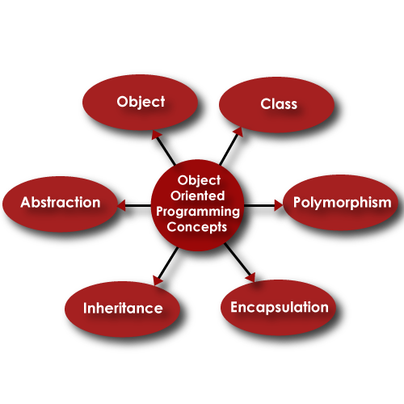
Object Oriented Programming concepts

Slide 7
Object Oriented Programming concepts
Class - A class is a collection of method and variables. It is a blueprint that defines the data and behavior of a type.
Let’s take HumanBeing as a class. A class is a blueprint for any functional entity which defines its properties and its functions. Like Human Being, having various attributes, performing various actions.
Objects – Instances of the class
My name is Mariam, and I am an instance/object of class HumanBeing. When we say, Human Being, we just mean a kind, you, your friend, and I. We are the forms of these classes. We have a physical existence while a class is just a logical definition. We are the objects.

Slide 8
Object Oriented Programming concepts
Abstraction
Abstraction means, showcasing only the required things to the outside world while hiding the details.
Continuing our example, Human Being’s can talk, walk, hear, eat, but the details of the muscles mechanism and their connections to the brain are hidden from the outside world.
The concept of abstraction focuses on what an object does, instated of how an object is represented or “how it works.” Thus, data abstraction is often used for managing large and complex programs.

Slide 9
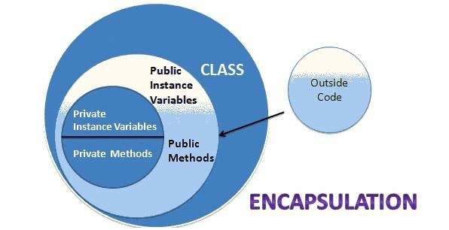
Object Oriented Programming concepts
Encapsulation
The mechanism that binds together code and the data it manipulates, and keeps both safe from outside interference and misuse.
Wrapping up data member and method together into a single unit (i.e. Class) is called Encapsulation.
Encapsulation is a technique used to protect the information in an object from the other object.

Slide 10
Object Oriented Programming concepts
Inheritance
Inheritance is a feature of object-oriented programming that allows code reusability when a class includes property of another class.
Considering HumanBeing a class, which has properties like hands, legs, eyes, mouth, etc, and functions like walk, talk, eat, see, etc.
Man and Woman are also classes, but most of the properties and functions are included in HumanBeing. Hence, they can inherit everything from class HumanBeing using the concept of Inheritance.

Slide 11
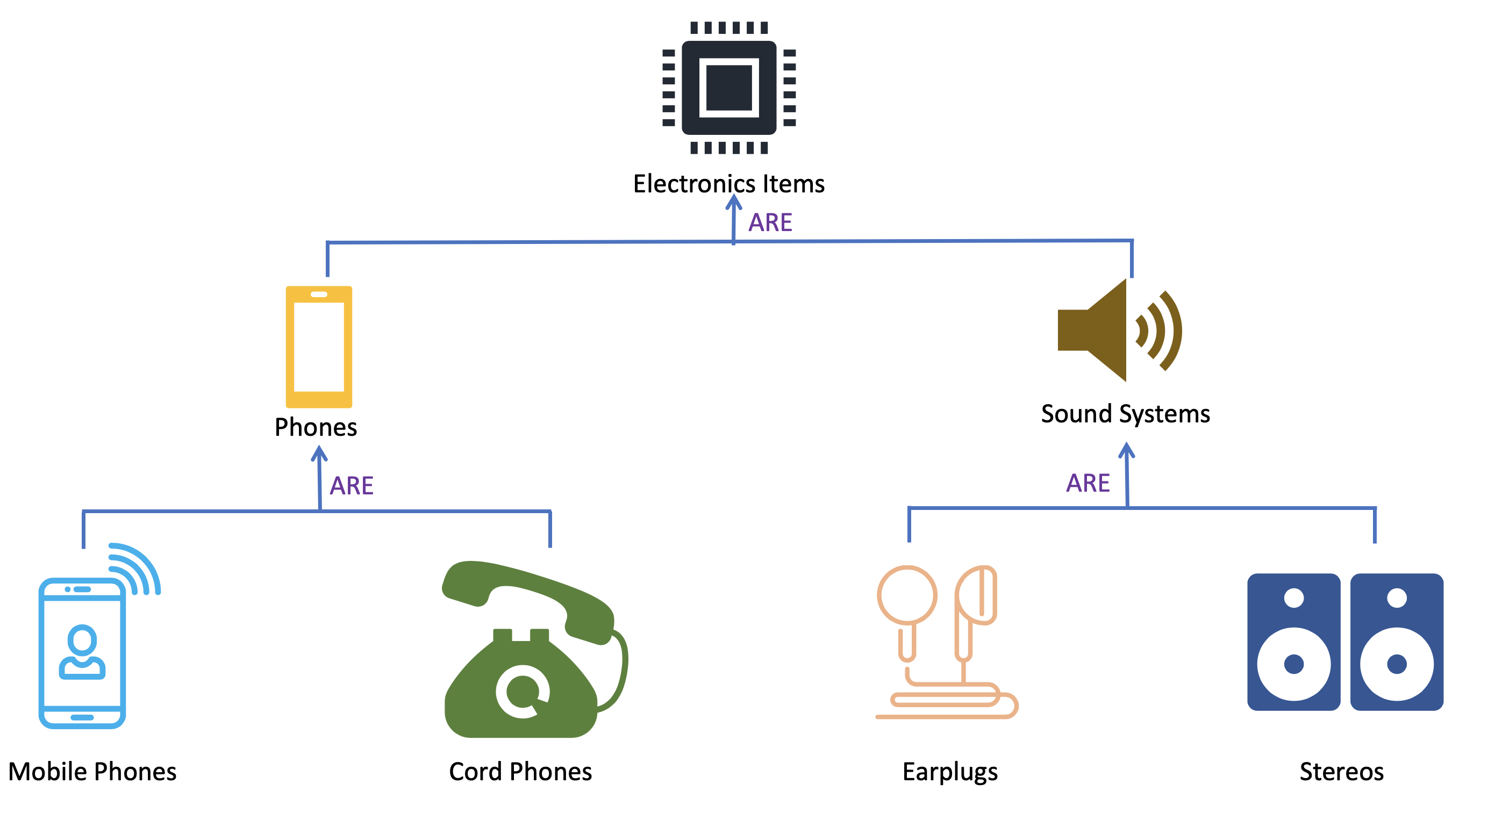
Object Oriented Programming concepts
Inheritance

Slide 12
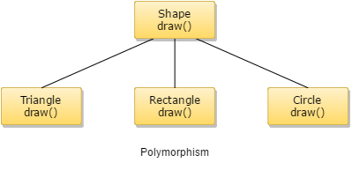
Object Oriented Programming concepts
Polymorphism
Polymorphism means one name many forms.
One function behaves in different forms.
In other words, "Many forms of a single object is called Polymorphism."
For Example, A HumanBeing behaves like a SON in the house, at the same time that person behaves like an EMPLOYEE in office.
Example 2:

Slide 13
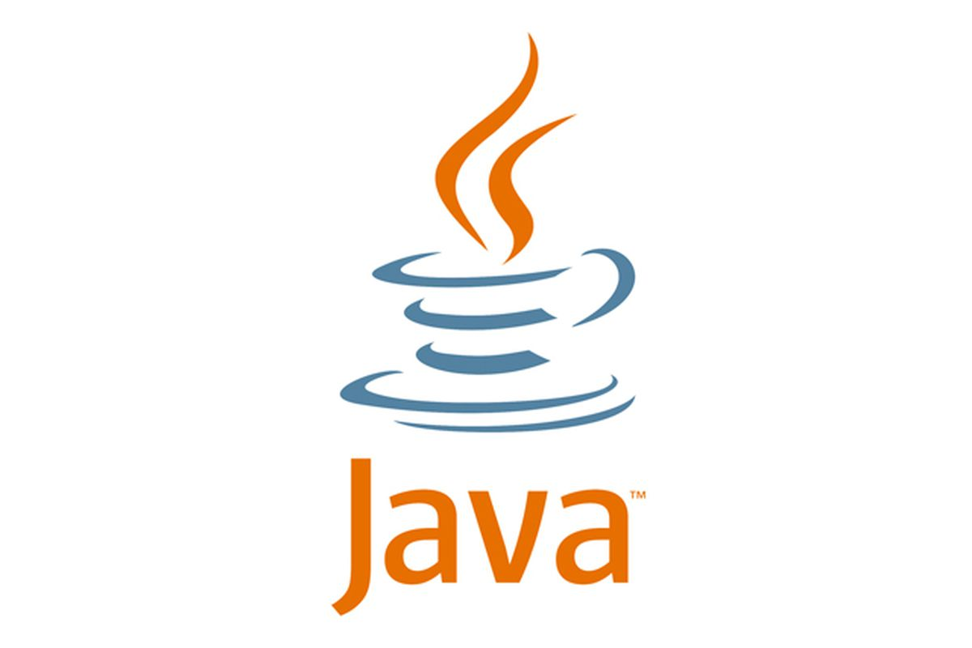
History of JAVA
Java is an object oriented language developed by a team lead by james gosling in 1991 at Sun Microsystems- called green team.
Initially it was called as GreenTalk and its file extension was .gt
Later on It was started as project named as Oak, but later on changed to Java.
In 1995 when team decided to register the name Oak, they decided to change the name because it was already a registered trademark by Oak technologies.
So the new name Java was suggested by the team among several other names.
Java is an island of the Indonesia where first coffee was produced.
Language creators were also keen consumers of coffee
Java is not an acronym, it is just a name.

Slide 14
Contd.
Goal of the green project was to examine upcoming consumer electronics market.
Purpose was to develop a programming language which will be platform neutral
Platform ?
Environment in which program runs- e.g. Operating System- Window OS, Linux etc.
Provide a platform for executing software on our computer
Any software capable executing on various platforms is known as platform independent software.
This was the key intention behind the development of Java.
In January 2010 Sun Microsystems was acquired by oracle corporation.
That’s why we call Java as product of Oracle.

Slide 15

Flavors of java
Java is categorized into three flavors:
Java Standard Edition- simple general-purpose desktop applications
Java Enterprise Edition- for business purpose ( Desktop base and web base appliations)
Java Micro Edition-for embedded systems( e.g. Mobile phones, PDAs etc )
Java Versions
Java 1.0 to 1.4 (1996- 2002)
Java 5 to 16 ( 2004-2021)

Slide 16
Features of java
Simple:
Java was designed to be easy for the professional programmer to learn and use effectively.
Object-oriented
Supports object-orientation
Multithreaded
Java supports multithreaded programming, which allows you to write programs that do many things simultaneously.

Slide 17
Features of java
Robust
Java frees you from having to worry about many of the most common causes of programming errors. Because Java is a strictly typed language, it checks your code at compile time. However, it also checks your code at run time. In fact, many hard-to-track-down bugs that often turn up in hard-to-reproduce run-time situations are simply impossible to create in Java.
Architecture-neutral
Write once; run anywhere, any time, forever.
Interpreted and High performance
Intermediate representation called Java bytecode
Bytecode is easy to translate directly into native machine code for very high performance by using a just-in-time compiler.

Slide 18
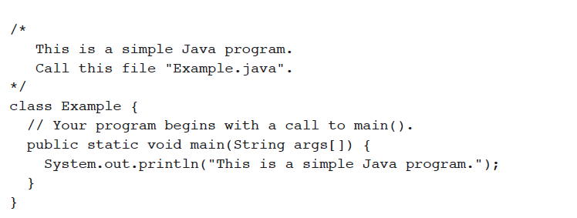
A SIMPLE JAVA Program

Slide 19
Compiling & Running a Java Program
The first thing that you must learn about Java is that the name you give to a source file is very important. For this example, the name of the source file should be Example.java
a source file is officially called a compilation unit-a text file that contains one or more class definitions. The Java compiler requires that a source file use the .java filename extension.
As you can see by looking at the program, the name of the class defined by the program is also Example.
This is not a coincidence. In Java, all code must reside inside a class. By convention, the name of that class should match the name of the file that holds the program.

Slide 20
Compiling & Running a Java Program
To compile the Example program, execute the compiler, javac, specifying the name of the source file on the command line, as shown here:
C:\>javac Example.java
The javac compiler creates a file called Example.class that contains the bytecode version of the program.
The Java bytecode is the intermediate representation of your program that contains instructions the Java interpreter will execute. Thus, the output of javac is not code that can be directly executed.
To actually run the program, you must use the Java interpreter, called java. To do so, pass the class name Example as a command-line argument, as shown here:
C:\>java Example

Slide 21
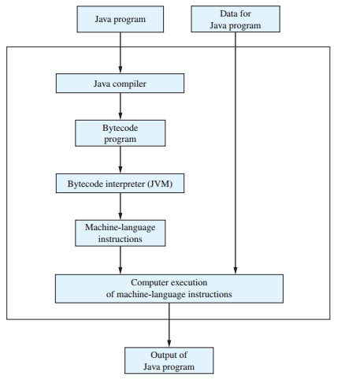
Compiling and Running a java Program
Java compiler compiles your program into bytecode rather than machine language.
This bytecode is a machine language for the Virtual Machine.
For converting bytecode into native machine code, java virtual machine(JVM) is used.
The JVM contains an Interpreter and JIT Compiler that translates and executes bytecode.
Bytecode promotes Portability.

Slide 22
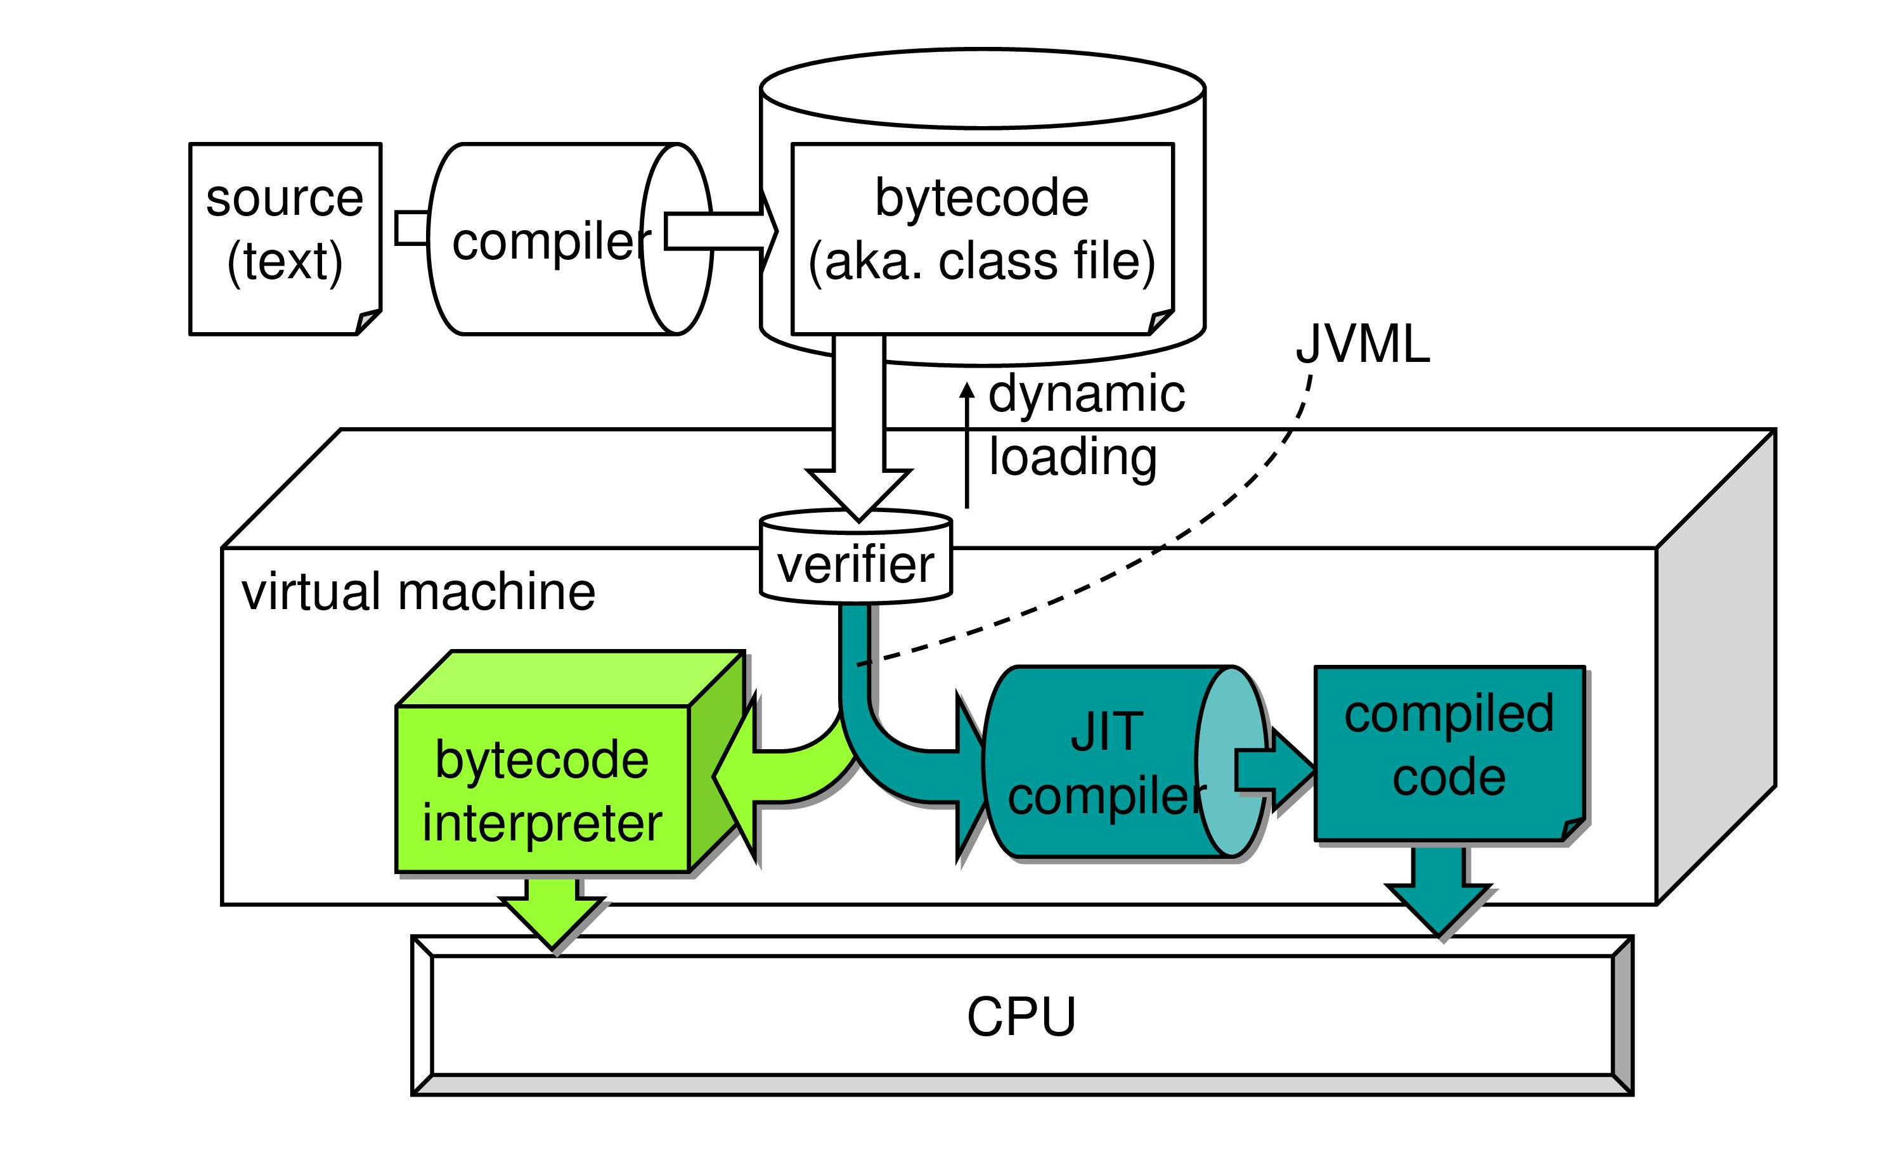
Execution model of JAVA

Slide 23
A SIMPLE JAVA Program

Slide 24
Understanding A simple JAVA Program
Although Example.java is quite short, it includes several key features which are common to all Java programs. The program begins with the following lines:
/*This is a simple Java program.
Call this file "Example.java“ */
This is a comment. Like most other programming languages, Java lets you enter a remark into a program’s source file. The contents of a comment are ignored by the compiler.
Instead, a comment describes or explains the operation of the program to anyone who is reading its source code.

Slide 25
Understanding A simple JAVA Program
The next line of code in the program is shown here:
class Example {
This line uses the keyword class to declare that a new class is being defined.
Example is an identifier that is the name of the class. The entire class definition, including all of its members, will be between the opening curly brace ({) and the closing curly brace (}).
The next line in the program is the single-line comment, shown here:
// Your program begins with a call to main().

Slide 26
Understanding A simple JAVA Program
The next line of code is shown here:
public static void main(String args[]) {
This line begins the main( ) method. As the comment preceding it suggests, this is the
line at which the program will begin executing. All Java applications begin execution by calling main( ).

Slide 27
Understanding A simple JAVA Program
The public keyword is an access specifier, which allows the programmer to control
the visibility of class members. When a class member is preceded by public, then that member may be accessed by code outside the class in which it is declared.
The opposite of public is private, which prevents a member from being used by code defined outside of its class.
In this case, main( ) must be declared as public, since it must be called by code outside of its class when the program is started.

Slide 28
Understanding A simple JAVA Program
The keyword static allows main( ) to be called without having to instantiate a particular instance of the class. This is necessary since main( ) is called by the Java interpreter before any objects are made.
The keyword void simply tells the compiler that main( ) does not return a value.
As you will see, methods may also return values.
As stated, main( ) is the method called when a Java application begins. Keep in mind that Java is case-sensitive. Thus, Main is different from main.

Slide 29
Understanding A simple JAVA Program
Any information that you need to pass to a method is received by variables specified within the set of parentheses that follow the name of the method. These variables are called parameters
In main( ), there is only one parameter, albeit a complicated one. String args[ ] declares a parameter named args, which is an array of instances of the class String.
The last character on the line is the {.
This signals the start of main( )’s body.
All of the code that comprises a method will occur between the method’s opening curly brace and its closing curly brace.

Slide 30
Understanding A simple JAVA Program
The next line of code is shown here. Notice that it occurs inside main( ).
System.out.println("This is a simple Java program.");
This line outputs the string “This is a simple Java program.” followed by a new line on the screen.
Output is actually accomplished by the built-in println( ) method.
In this case, println( ) displays the string which is passed to it.
As you will see, println( ) can be used to display other types of information, too.
The line begins with System.out. System is a predefined class that provides access to the system, and out is the output stream that is connected to the console.

Slide 31
THANK YOU!

